Slide 1
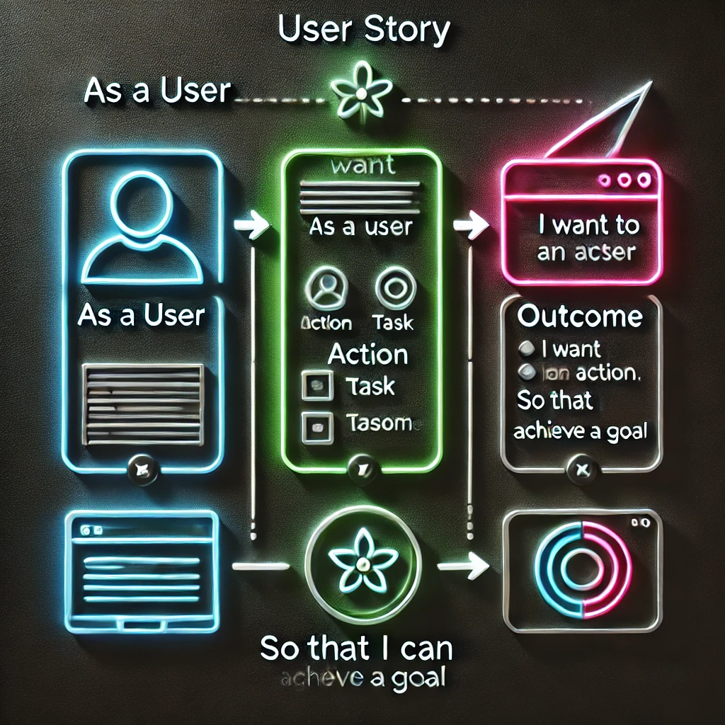
User story
Bridging User Needs and Design Solutions.
By Samyog Khadka

Slide 2
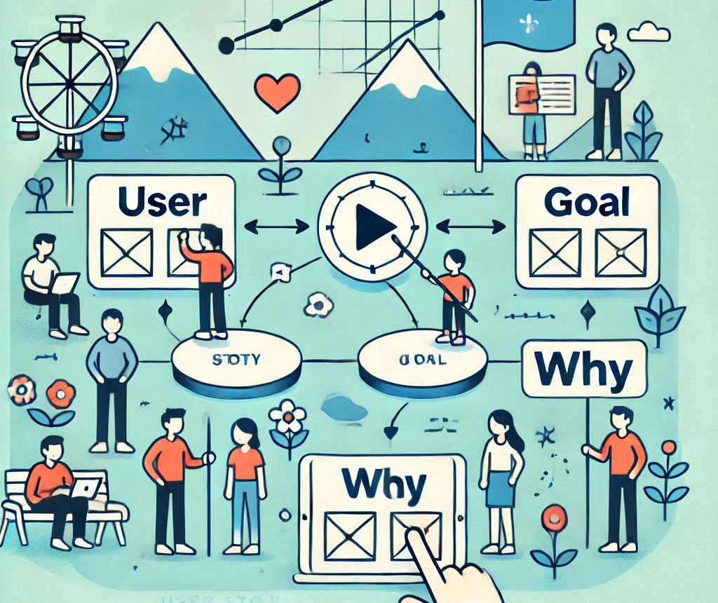
What are User Stories?
Definition: Short descriptions of a feature from the user's perspective.
Example:
"As a student, I want a progress tracker so that I can monitor my learning journey."

Slide 3
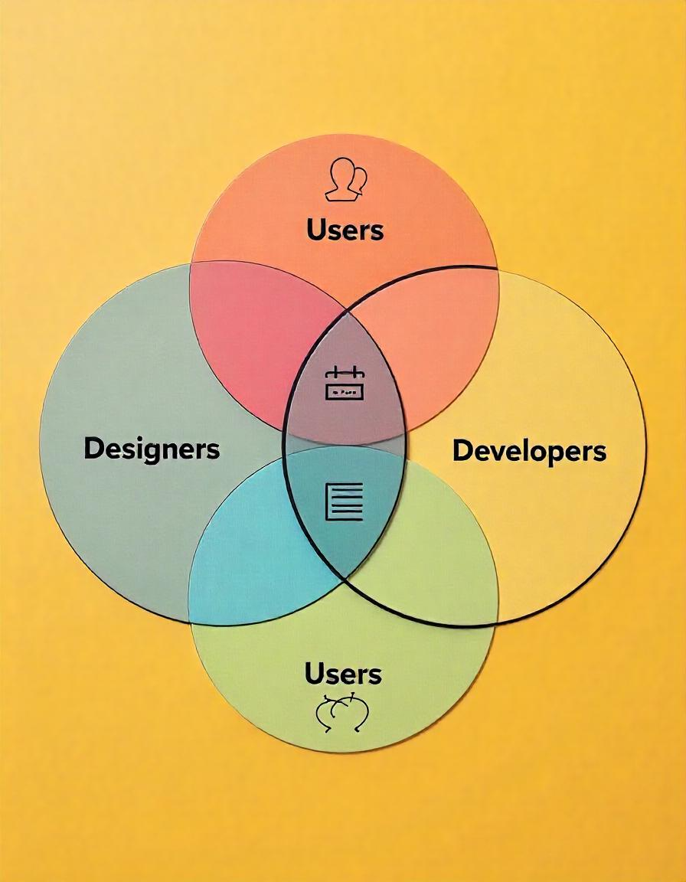
Importance in UI/UX Design
Keeps the design user-focused.
Facilitates collaboration among teams.
Enhances user satisfaction through goal-oriented features.

Slide 4
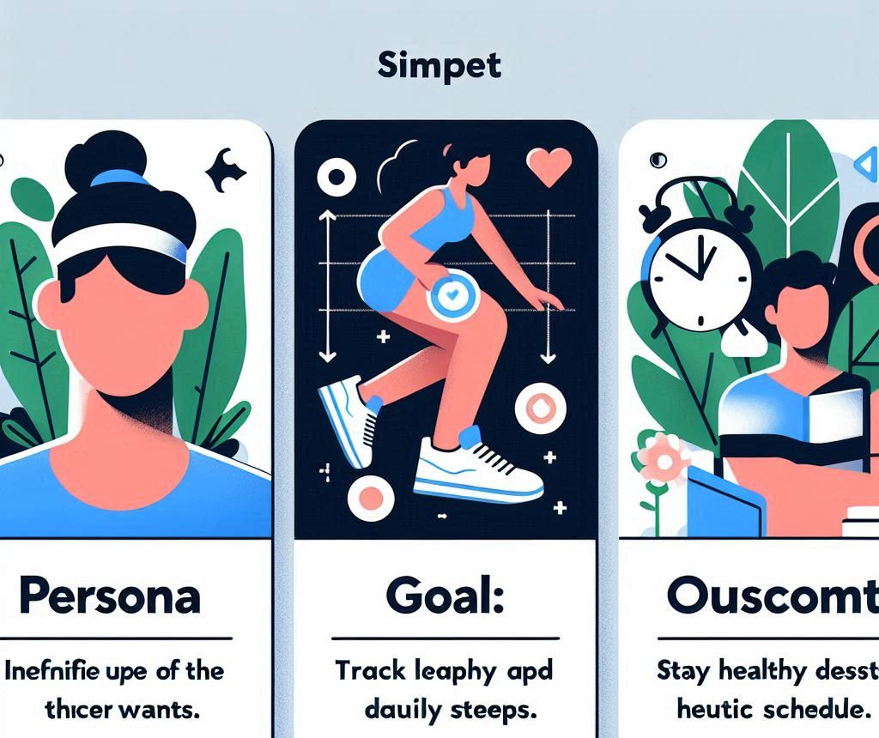
Components of a Good User Story
Persona: Identify the user.
Goal: Define what the user wants.
Outcome: Explain why it matters.
Example:
For a Fitness App:
Persona: Busy professional.
Goal: Track daily steps.
Outcome: Stay healthy despite a hectic schedule.
Outcome:
Busy professional.
Track daily steps.
Stay healthy despite a hectic schedule.
Stay healthy despite a hectic schedule.

Slide 5
Examples of User Stories
Travel App:
"As a traveler, I want to receive flight updates so that I can manage my schedule."
Banking App:
"As a user, I want biometric login so that I can securely access my account."

Slide 6
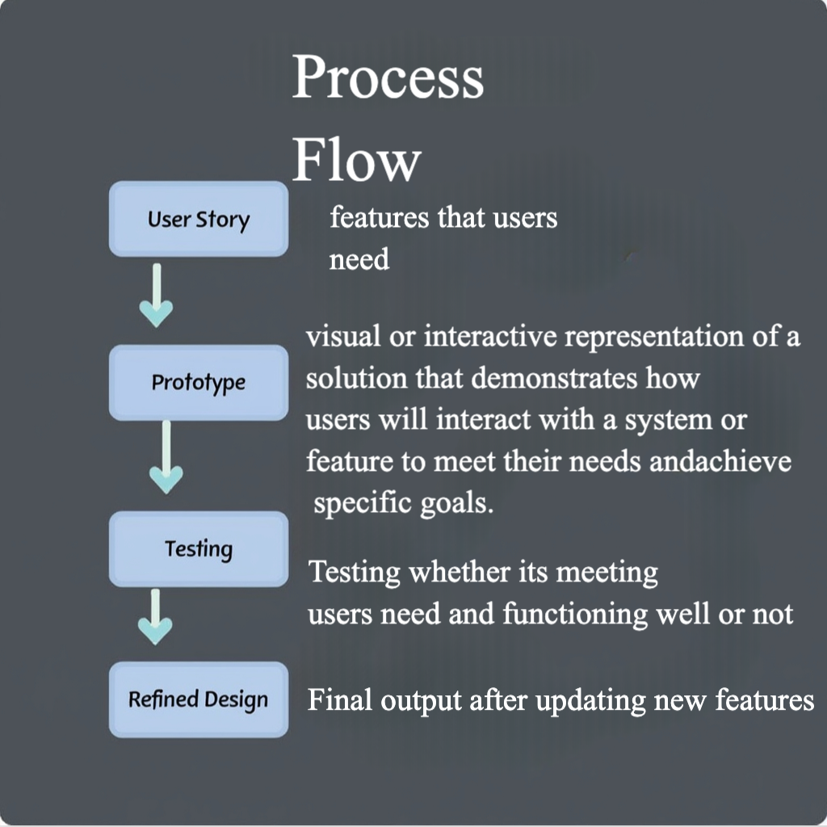
User Stories in the Design Process
Guide wireframes and prototypes.
Prioritize features during development.
Validate designs through usability testing.

Slide 7
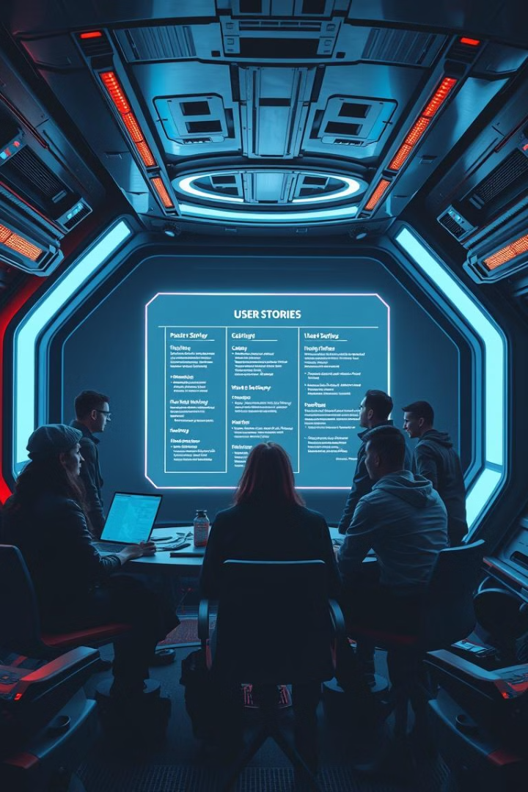



Importance of User Stories
User-Centric Approach
Focuses on user needs and goals, keeping the user at the heart of the design process.
Prioritize Features
Helps prioritize features based on user value and impact.
Guide Development
Provides clear guidance for the development team to deliver value to users.

Slide 8

Conclusion
User stories are essential for user-centered design.
They ensure functionality aligns with user needs.
Encourage continuous user feedback.

Slide 9
Any Queries?

